Slide 1



Introduction to Basic Manufacturing Process Lab ME29201
Demonstration of measurement of surface roughness generated using turning and end milling
Department of Mechanical Engineering IIT Kharagpur

Slide 2
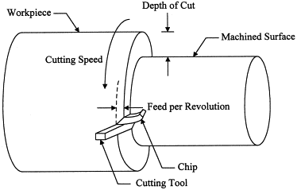
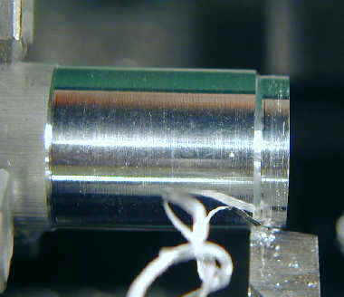
Turning operation
Illustration of turning operation [1]
Chip formation during turning operation [2]
Turning is the removal of metal from the outer diameter of a rotating cylindrical workpiece.

Slide 3
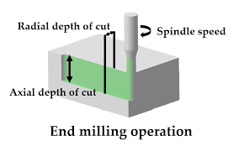
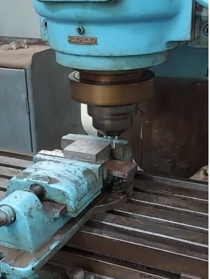
End-milling operation
Illustration of end-milling operation [3]
Machine set-up for end milling
[IIT Kharagpur lab]
Milling is the process of machining using rotary cutters to remove material by advancing a cutter into a workpiece.

Slide 4
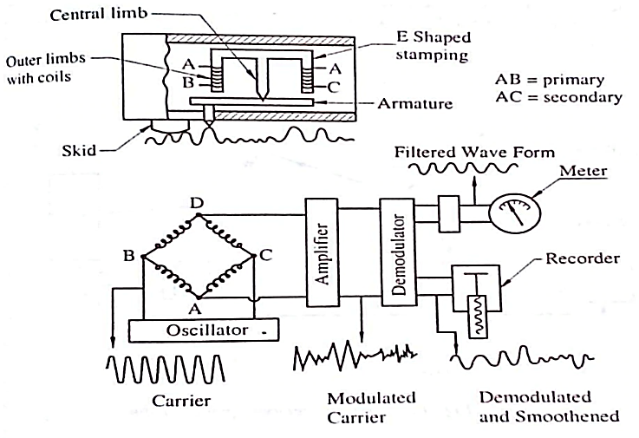
Talysurf Surface Profilometer
Illustration of working model of Talysurf surface roughness tester [4]

Slide 5
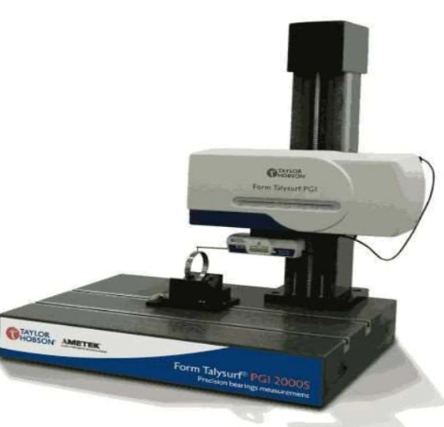
Advantage and limitations of Talysurf Surface Profilometer
Advantages
Its response is more rapid.
It is accurate as compared to Tomlinson Surface meter.
It gives ×20 and ×100 horizontal magnification.
Limitations
Initial cost is high.
Measurements are limited to a section of a surface.
Needs skilled operators for measurements.
Distance between stylus and skid and the shape of the skid introduce errors in measurement for wavy surfaces.
Talysurf surface roughness tester [5]

Slide 6
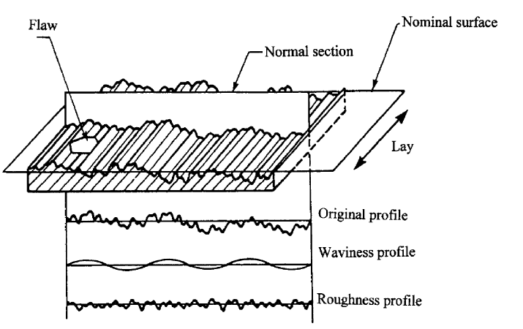
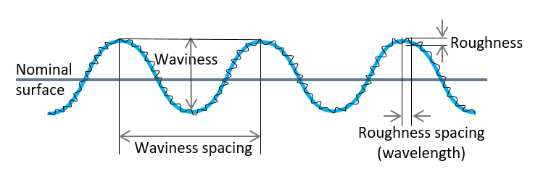
Surface Roughness and Waviness
Illustration of surface roughness and waviness in 3D and 2D [6]

Slide 7
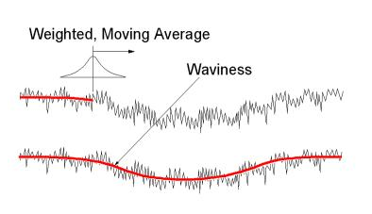
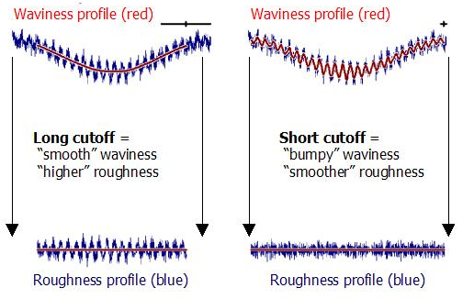
Filter technique of surface roughness from waviness
Filtering surface profile involves running a “smoothing” filter through the primary data.
Shorter wavelengths fall into the roughness profile.
Longer wavelengths appear in the waviness profile.
“Gaussian” filter is recommended in ASME and ISO standards [7]

Slide 8
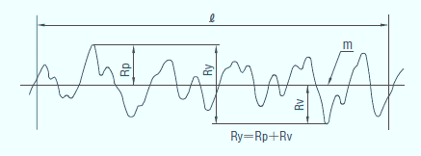
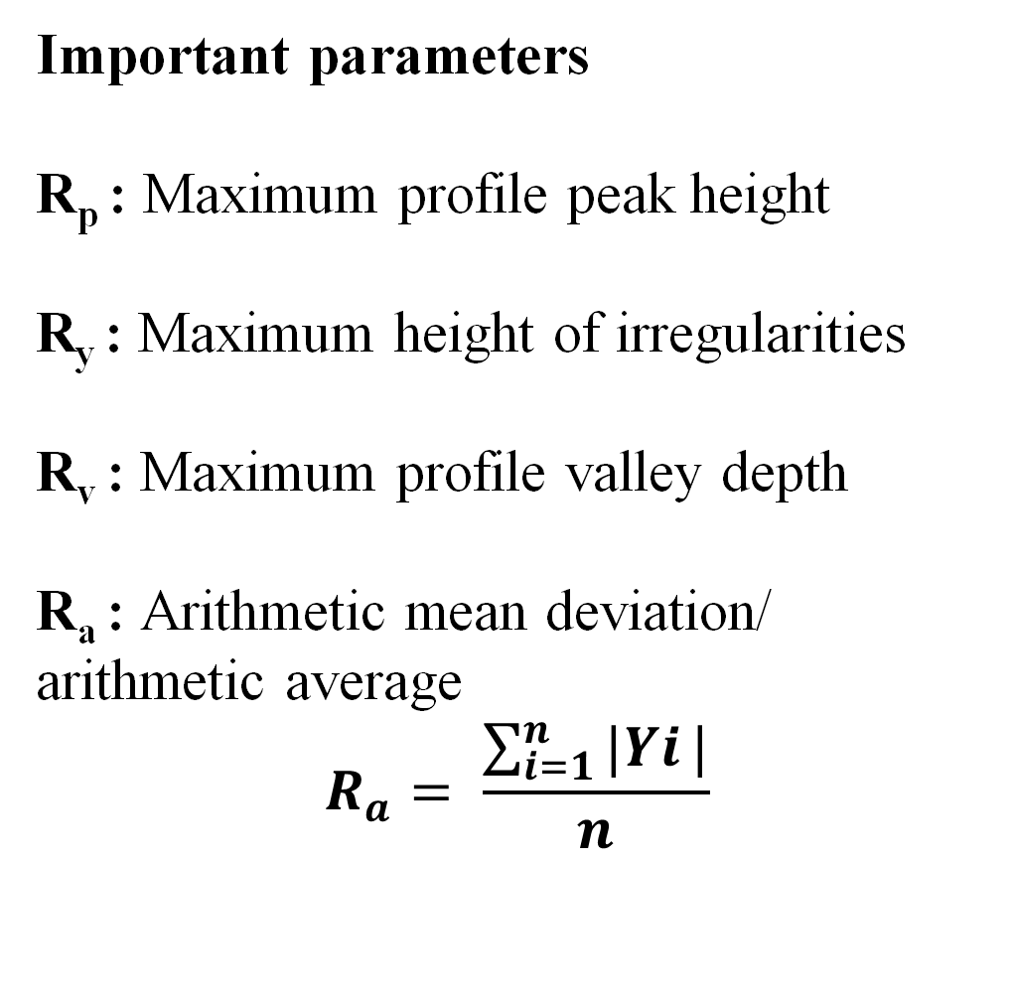
Surface roughness parameter (Deterministically)
Important parameters
R_{p} : Maximum profile peak height
R_{y} : Maximum height of irregularities
R_{v} : Maximum profile valley depth
R_{a} : Arithmetic mean deviation/ arithmetic average
$$R_{a}= \frac{\sum_{i=1}^{n}{|Yi}|}{n}$$
Representation of surface roughness parameter [8]

Slide 9
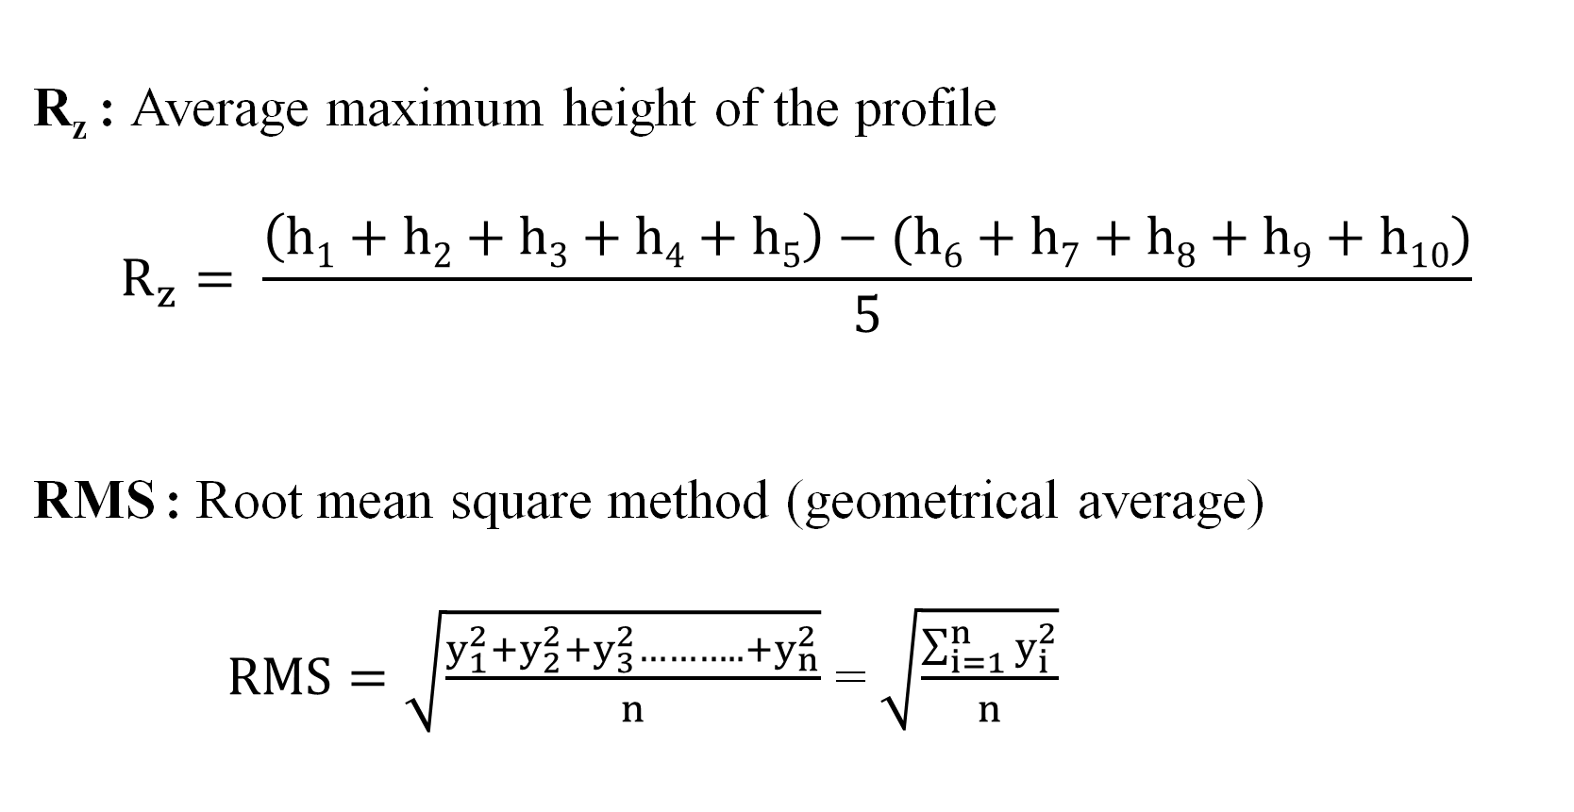
Surface roughness parameter (Deterministically)
R_{z} : Average maximum height of the profile
$$R_{z}= \frac{\left(h1+h2+h3+h4+h5\right)−(h6+h7+h8+h9+h10)}{5}$$
RMS : Root mean square method (geometrical average)
$RMS=\sqrt{\frac{y_{1}^{2}+y_{2}^{2}+y_{3}^{2}………..+y_{n}^{2}}{n}}$ = $\sqrt{\frac{\sum_{i=1}^{n}{y_{i}^{2}}}{n}}$

Slide 10
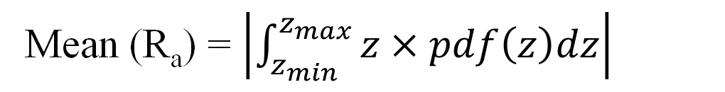
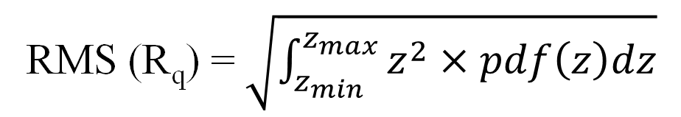
Surface roughness parameter (Probabilistically)
R_{a} : Arithmetic mean deviation or arithmetic average
Mean (R_{a}) = $\left|\int_{z_{min}}^{z_{max}}{z×pdf\left(z\right)dz}\right|$
RMS : Root mean square Roughness
RMS (R_{q}) = $\sqrt{\int_{z_{min}}^{z_{max}}{z^{2}×pdf\left(z\right)dz}}$

Slide 11
References
[1] Tosun, Nihat & Özler, Latif. (2004). Optimisation for hot turning operations with multiple performance characteristics. The International Journal of Advanced Manufacturing Technology.
[2] http://www.mini-lathe.com/Mini_lathe/Operation/Turning/turning.htm
[3] A Study of the Effects of Machining Parameters on the Surface Roughness in the End-Milling Process. Jordan Journal of Mechanical and Industrial Engineering. 1.
[4] https://www.taylor-hobson.com
[5] https://what-when-how.com/metrology/direct-instrument-measurements-metrology/
[6] J.Raja, et al (2002). Recent advances in separation of roughness, waviness and form. Precision
Engineering. 26. 222-235. 10.1016/S0141-6359(02)00103-4.
[7] https://digitalmetrology.com/tutorials/3-steps-to-understanding-surface-texture/
[8] https://roslerblog.com/2016/05/27/surface-roughness-measurement/

